Slide 1
26
Templates

Slide 2
Behind that outside pattern
the dim shapes get clearer every day.
It is always the same shape, only very numerous.
  Charlotte Perkins Gilman
Every man of genius sees the world at a different angle from his fellows.
  Havelock Ellis
...our special individuality, as distinguished from our generic humanity.
  Oliver Wendell Holmes, Sr

Slide 3
OBJECTIVES
In this chapter you will learn:
To use function templates to conveniently create a group of related (overloaded) functions.
To distinguish between function templates and function-template specializations.
To use class templates to create a group of related types.
To distinguish between class templates and class-template specializations.
To overload function templates.
To understand the relationships among templates, friends, inheritance and static members.

Slide 4
26.1 Introduction
26.2 Function Templates
26.3 Overloading Function Templates
26.4 Class Templates
26.5 Nontype Parameters and Default Types for Class Templates
26.6 Notes on Templates and Inheritance
26.7 Notes on Templates and Friends
26.8 Notes on Templates and static Members
26.9 Wrap-Up

Slide 5
26.1 Introduction
Function templates and class templates
  Enable programmers to specify an entire range of related functions and related classes
    Called function-template specializations and class-template specializations, respectively
  Generic programming
  Analogy: templates are like stencils, template specializations are like separate tracings
    All tracings have the same shape, but they could have different colors

Slide 6
Software Engineering Observation 26.1
Most C++ compilers require the complete definition of a template to appear in the client source-code file that uses the template. For this reason and for reusability, templates are often defined in header files, which are then #included into the appropriate client source-code files. For class templates, this means that the member functions are also defined in the header file.

Slide 7
26.2 Function Templates
Function Templates
  Used to produce overloaded functions that perform identical operations on different types of data
    Programmer writes a single function-template definition
    Compiler generates separate object-code functions (function-template specializations) based on argument types in calls to the function template
  Similar to macros in C, but with full type checking

Slide 8
Error-Prevention Tip 26.1
Function templates, like macros, enable software reuse. Unlike macros, function templates help eliminate many types of errors through the scrutiny of full C++ type checking.

Slide 9
26.2 Function Templates (Cont.)
Function-template definitions
  Preceded by a template header
    Keyword template
    List of template parameters
      Enclosed in angle brackets (< and >)
      Each template parameter is preceded by keyword class or keyword typename (both are interchangeable)
      Used to specify types of arguments to, local variables in and return type of the function template
    Examples
      template< typename T >
      template< class ElementType >
      template< typename BorderType, typename Filltype >

Slide 10
Common Programming Error 26.1
Not placing keyword class or keyword typename before each type template parameter of a function template is a syntax error.

Slide 11
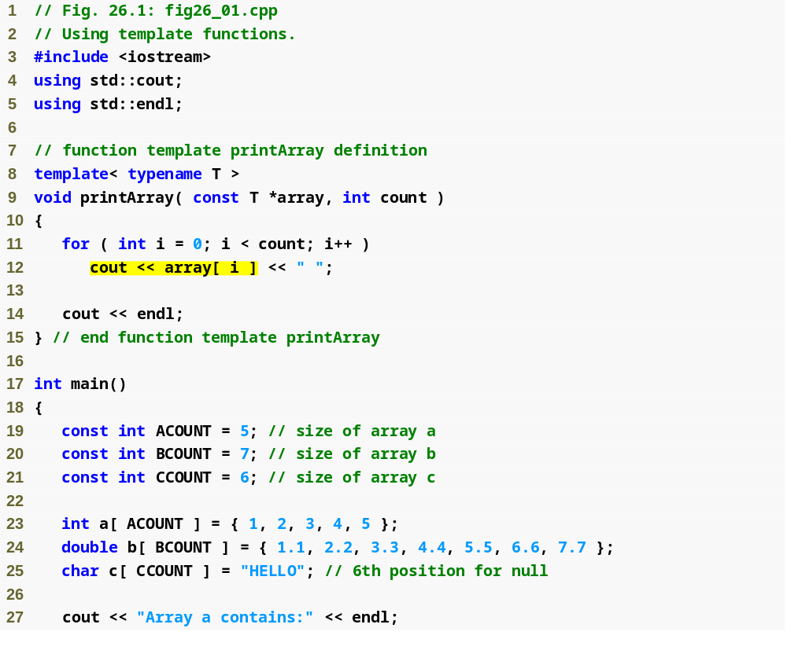
Outline
Type template parameter T specified in template header
fig26_01.cpp
(1 of 2)

Slide 12
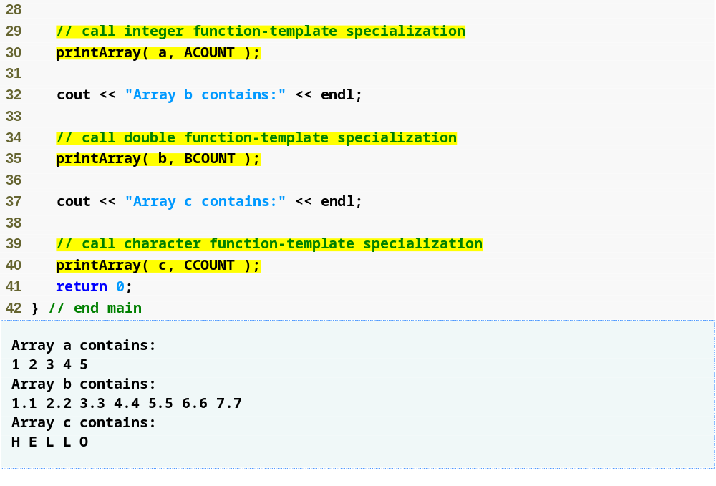
Outline
Creates a function-template specialization of printArray where int replaces T
fig26_01.cpp
(2 of 2)
Creates a function-template specialization of printArray where double replaces T
Creates a function-template specialization of printArray where char replaces T

Slide 13
Common Programming Error 26.2
If a template is invoked with a user-defined type, and if that template uses functions or operators (e.g., ==, +, <=) with objects of that class type, then those functions and operators must be overloaded for the user-defined type. Forgetting to overload such operators causes compilation errors.

Slide 14
Performance Tip 26.1
Although templates offer software-reusability benefits, remember that multiple function-template specializations and class-template specializations are instantiated in a program (at compile time), despite the fact that the template is written only once. These copies can consume considerable memory. This is not normally an issue, though, because the code generated by the template is the same size as the code the programmer would have written to produce the separate overloaded functions.

Slide 15
26.3 Overloading Function Templates
A function template may be overloaded
  Other function templates that specify the same name but different parameters
  Nontemplate functions that specify the same name but different parameters
  The compiler chooses the best function or specialization to match the function call
    A nontemplate function is chosen over a template specialization in case of a tie
    Otherwise, multiple matches results in a compilation error (the compiler considers the function call to be an ambiguous function call )

Slide 16
Common Programming Error 26.3
If no matching function definition can be found for a particular function call, or if there are multiple matches, the compiler generates an error.

Slide 17
26.4 Class Templates
Class templates (or parameterized types)
  Class-template definitions are preceded by a header
    Such as template< typename T >
  Type parameter T can be used as a data type in member functions and data members
  Additional type parameters can be specified using a comma-separated list
    As in template< typename T1, typename T2 >

Slide 18
Software Engineering Observation 26.2
Class templates encourage software reusability by enabling type-specific versions of generic classes to be instantiated.

Slide 19
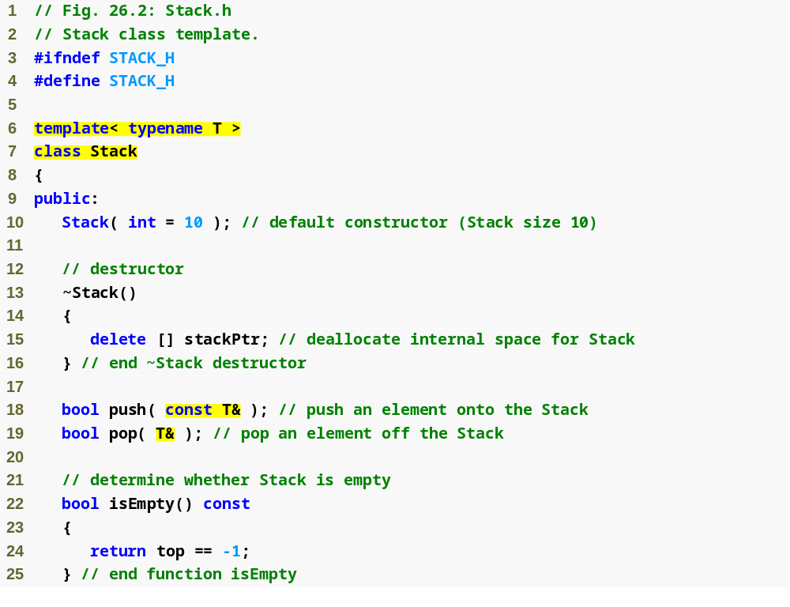
Outline
Stack.h
(1 of 3)
Create class template Stack with type parameter T
Member functions that use type parameter T in specifying function parameters

Slide 20
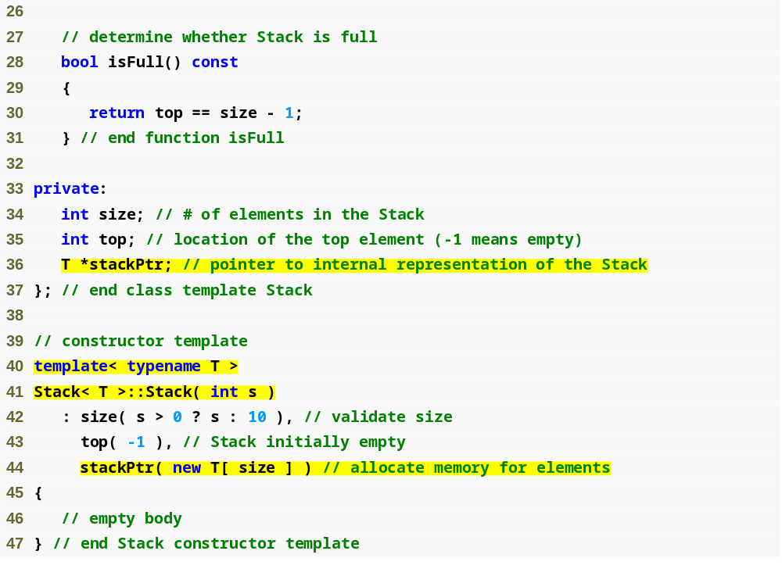
Outline
Stack.h
(2 of 3)
Data member stackPtr is a pointer to a T
Member-function template definitions that appear outside the class-template definition begin with the template header

Slide 21
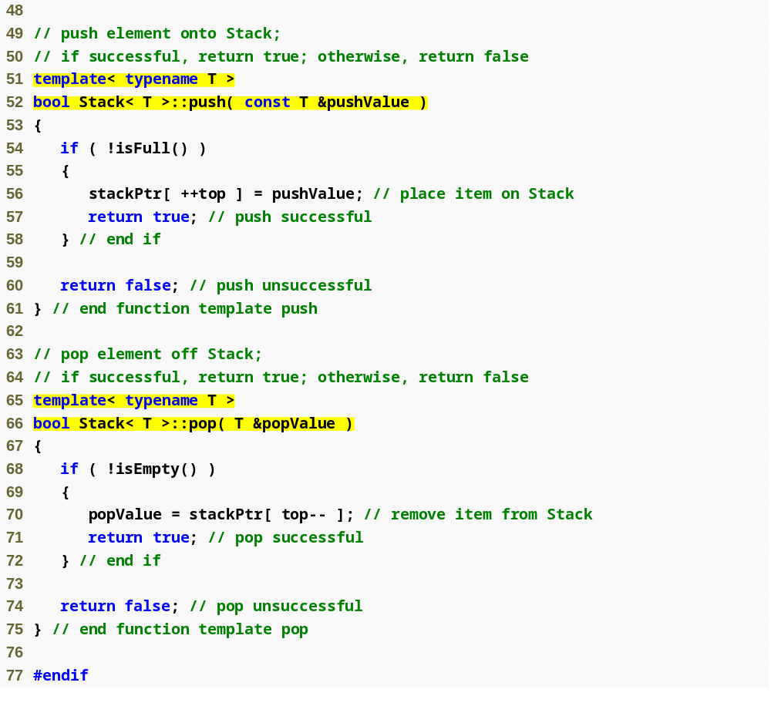
Outline
Stack.h
(3 of 3)

Slide 22
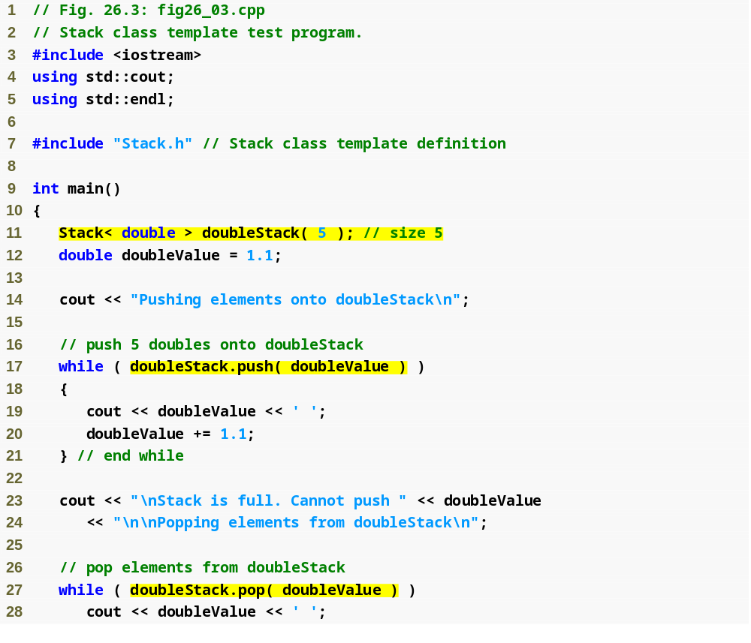
Outline
fig26_03.cpp
(1 of 3)
Create class-template specialization Stack< double > where type double is associated with type parameter T

Slide 23
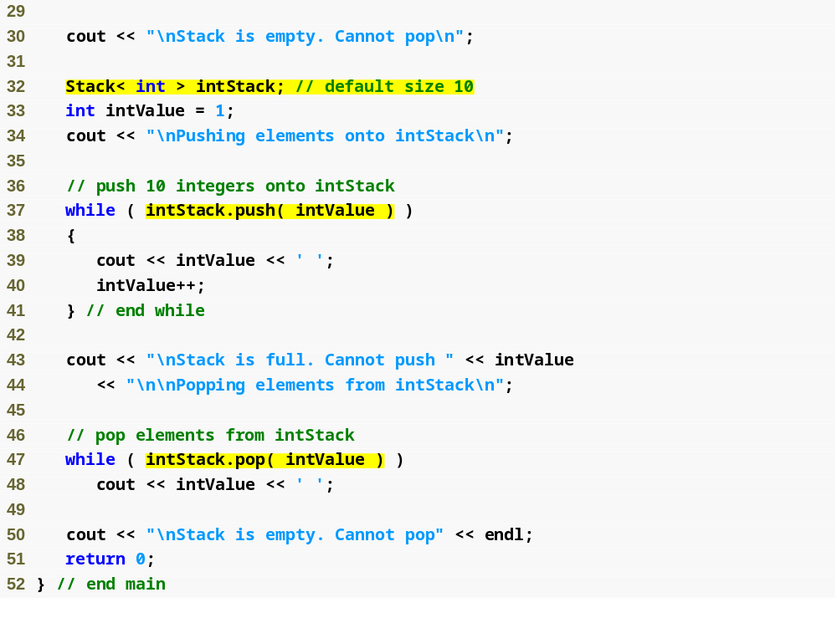
Outline
fig26_03.cpp
(2 of 3)
Create class-template specialization Stack< int > where type int is associated with type parameter T

Slide 24
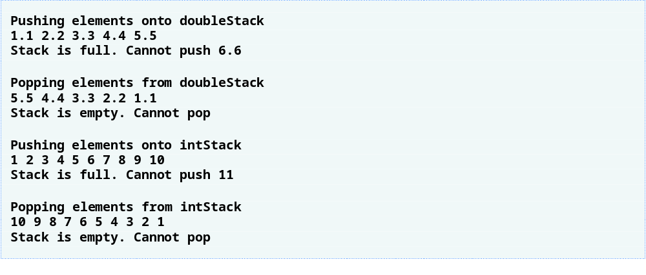
Outline
fig26_03.cpp
(3 of 3)

Slide 25
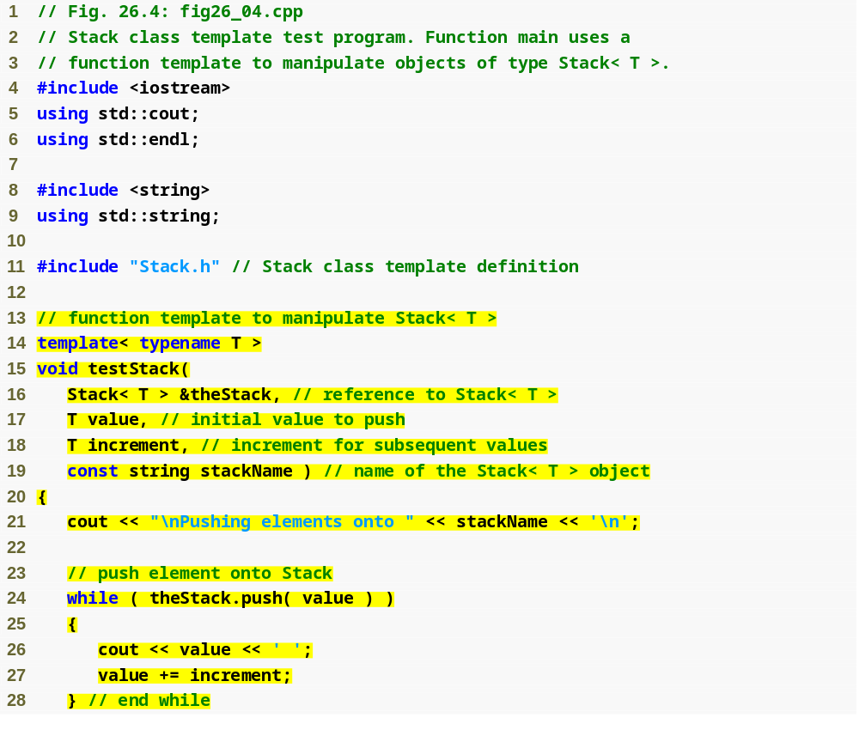
Outline
fig26_04.cpp
(1 of 3)
Use a function template to process Stack class-template specializations

Slide 26
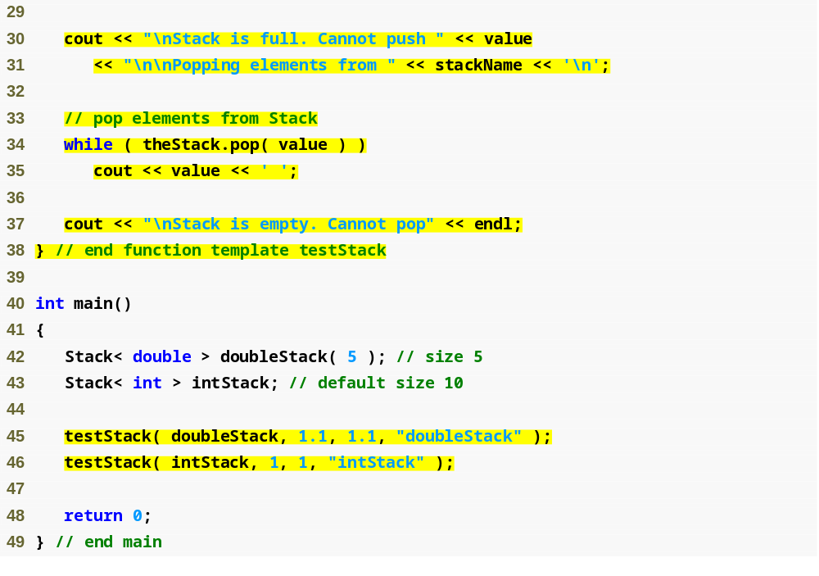
Outline
fig26_04.cpp
(2 of 3)

Slide 27

Outline
fig26_04.cpp
(3 of 3)

Slide 28
26.5 Nontype Parameters and Default Types for Class Templates
Nontype template parameters
  Can have default arguments
  Are treated as consts
  Example
    Template header:
    template< typename T, int elements >
    Declaration:
    Stack< double, 100 > salesFigures;
Type parameters can have default arguments too
  Example
    Template header:
    template< typename T = string >
    Declaration:
    Stack<> jobDescriptions;

Slide 29
Performance Tip 26.2
When appropriate, specify the size of a container class (such as an array class or a stack class) at compile time (possibly through a nontype template parameter). This eliminates the execution-time overhead of using new to create the space dynamically.

Slide 30
Software Engineering Observation 26.3
Specifying the size of a container at compile time avoids the potentially fatal execution-time error if new is unable to obtain the needed memory.

Slide 31
26.5 Nontype Parameters and Default Types for Class Templates (Cont.)
Explicit specializations
  Used when a particular type will not work with the general template or requires customized processing
  Example for an explicit Stack< Employee > specialization
    template<>
    class Stack< Employee >
    {
    …
    };
  Are complete replacements for the general template
    Do not use anything from the original class template and can even have different members

Slide 32
26.6 Notes on Templates and Inheritance
Templates and inheritance
  A class template can be derived from a class-template specialization
  A class template can be derived from a nontemplate class
  A class-template specialization can be derived from a class-template specialization
  A nontemplate class can be derived from a class-template specialization

Slide 33
26.7 Notes on Templates and Friends
Templates and friends
  Assume class template X with type parameter T as in:
  template< typename T > class X
    A function can be the friend of every class-template specialization instantiated from a class template
      friend void f1();
        f1 is a friend of X< double >, X< string >, etc.
    A function can be the friend of only a class-template specialization with the same type argument
      friend void f2( X< T > & );
        f2( X< float > & ) is a friend of X< float > but not a friend of X< string >

Slide 34
26.7 Notes on Templates and Friends (Cont.)
    A member function of another class can be the friend of every class-template specialization instantiated from a class template
      friend void A::f3();
        f3 of class A is a friend of X< double >, X< string >, etc.
    A member function of another class can be the friend of only a class-template specialization with the same type argument
      friend void C< T >::f4( X< T > & );
        C< float >::f4( X< float > & ) is a friend of X< float > but not a friend of X< string >

Slide 35
26.7 Notes on Templates and Friends (Cont.)
    Another class can be the friend of every class-template specialization instantiated from a class template
      friend class Y;
        Every member function of class Y is a friend of X< double >, X< string >, etc.
    A class-template specialization can be the friend of only a class-template specialization with the same type parameter
      friend class Z< T >;
        Class-template specialization Z< float > is a friend of X< float >, Z< string > is a friend of X< string >, etc.

Slide 36
26.8 Notes on Templates and static Members
static data members of a class template
  Each class-template specialization has its own copy of each static data member
    All objects of that specialization share that one static data member
    static data members must be defined and, if necessary, initialized at file scope
  Each class-template specialization gets its own copy of the class template’s static member functions

